Slide 1
Cell wall of bacteria
DR.SONAL MISHRA

Slide 2
Cell wall of bacteria-
Rough and rigid structure,
20-25 nm in thickness and weighs about 20-25% of dry weight of the cell.
Rigid part is peptidoglycan which is a mucopeptide composed of N-acetyl muramic acid and N-acetyl glucosamine molecules alternating in chains, cross linked by peptide sub units.

Slide 3
Chemical structure of bacterial cell wall –
Divided in to four layers-
Slime layer and capsule,
Surface appendages includes flagella and fimbriae ,
Cell envelop i.e. Cytoplasmic membrane and cytoplasm containing granular part, nucleoid, ribosome etc.
Function of cell wall of bacteria-
Shape of the bacteria,
Protection to the cell against osmotic damage,
Takes part in the cell division,
Posses target site for antibiotics, lysozymes and bacteriophages, carries bacterial antigens.

Slide 4
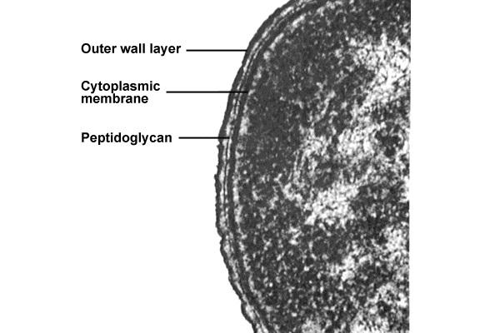
Cell walls of bacteria(2)

Slide 5
Cell walls of bacteria(3)

Slide 6
Cell walls of bacteria(4)

Slide 7
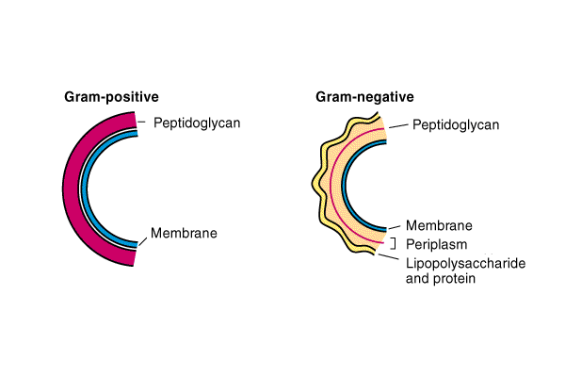
Cell walls of bacteria(1)

Slide 8
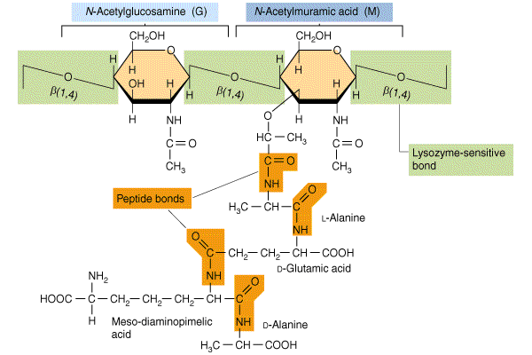
Structure of peptidoglycan(1)

Slide 9
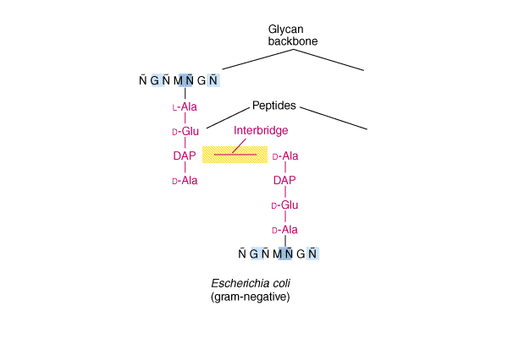
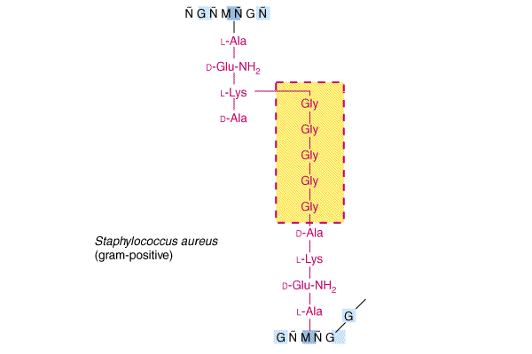
Structure of peptidoglycan(2)

Slide 10
a). Gram positive bacterial cell wall
Thick peptidoglycan layer
pentaglycin cross linkage.
Teichoic acid (TA): Polymer of ribitol & glycerol joined by phosphate groups
Some have peptioglycan teichoic acid.
All have lipoteichoic acid.

Slide 11
Function of Teichoic acids:
* Antigenic determinant
* Participate in the supply of Mg to the cell by binding Mg++
* regulate normal cell division.
For most part, protein is not found as a constituent of the G+ cell wall.

Slide 12
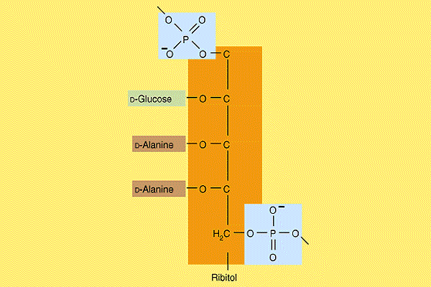
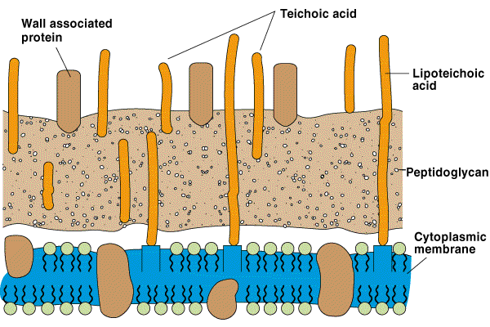
Structure of the Gram-positive Cell Wall

Slide 13
(b) Gram negative bacterial cell wall:
Thin peptidoglycan
Tetrapeptide cross linkage
A second membrane structure: protein and lipopolysaccharide (LPS).
polysaccharide- repeated sequences of a few sugars (e.g. gal- mann-rham) n=10-20 O antigen

Slide 14
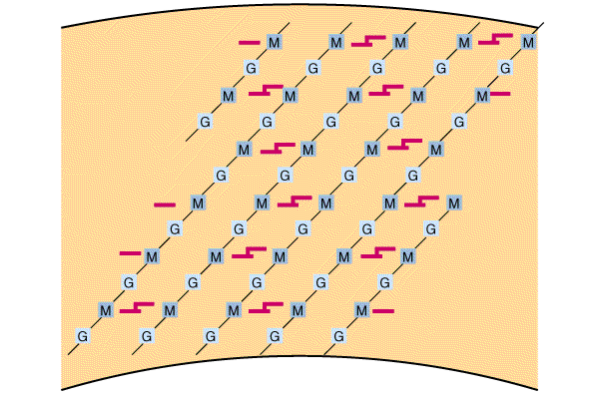
Structure of peptidoglycan(3)

Slide 15
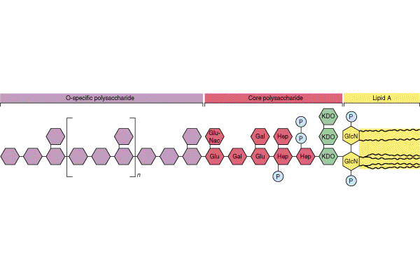
Chemistry of LPS

Slide 16
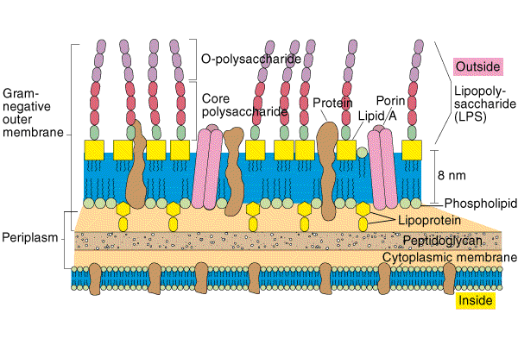
The Gram-negative outer membrane(1)

Slide 17
The Gram-negative outer membrane(2)

Slide 18
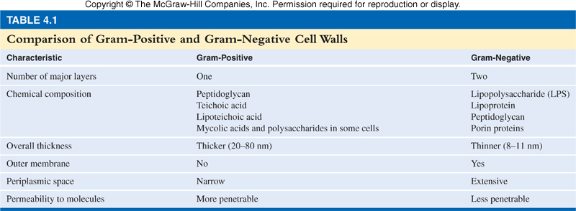

Slide 19
A typical Cell Walls
Some bacterial groups lack typical cell wall structure i.e. Mycobacterium and Nocardia
  Gram-positive cell wall structure with lipid mycolic acid (cord factor)
    pathogenicity and high degree of resistance to certain chemicals and dyes
    basis for acid-fast stain used for diagnosis of infections caused by these microorganisms
Some have no cell wall i.e. Mycoplasma
  cell wall is stabilized by sterols
  pleomorphic
19

Slide 20
2. Cell Membrane
Function:
a. control permeability
b. transporte’s and protons for cellular metabolism
c. contain enzymes to synthesis and transport
cell wall substance and for metabolism
d. secret hydrolytic enzymes
e. regulate cell division.
Fluid mosaic model. phospholipid bilayer and protein (structure and enzymatic function). Similar to eukaryotic cell membrane.

Slide 21
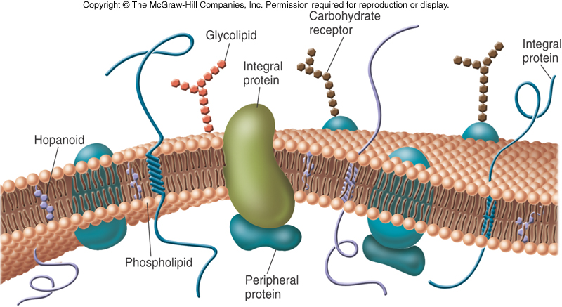
21

Slide 22
Functions of the cytoplasmic membrane(1)

Slide 23
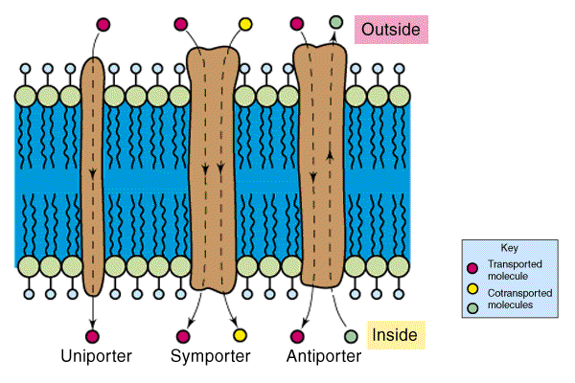
Functions of the cytoplasmic membrane(2)

Slide 24
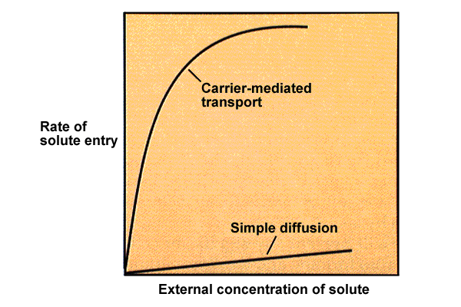
Transport proteins

Slide 25
THANK YOU

